Slide 1
iRasus
Energy Intelligence for a Greener World

Slide 2

What is iRasus
The world is in flux as it shifts to batteries. Transitioning to batteries comes with its challenges. We want to make this shift easier, safer, quicker, and less costly while being pioneers in the cleantech movement.
iRasus is a deeptech organisation developing analytical products to solve battery-related problems faced by stakeholders located across a battery’s value chain. Our products are used to solve key battery management and operational problems in the E-Mobility, Stationary Assets, Charging and Battery Manufacturing Sectors.

Slide 3
Who are we
2019
7500+
1000+
We have been working with key players in the battery space since the past 5 years.
5B+ data points across 7.5K+ assets have been processed to deliver Insights.
The industry is new. Our product has learnt to evolve with our clients. We have processed 1000+ metrics in real-time.
Expediting the clean energy transition by making working with batteries reliable, safe, and profitable
Notes:
Indus Towers is a leading player in the telecom infrastructure industry, providing passive infrastructure services to mobile network operators and other wireless service providers across India. With their extensive network of towers, they play a crucial role in enabling seamless mobile connectivity for millions of users.

Slide 4
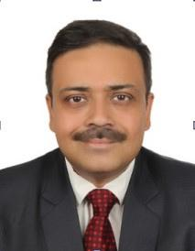

Our Founders
Arjun Sinha Roy
Anirudh Ramesh
CEO & CO-FOUNDER
CTO & CO-FOUNDER
BITS Pilani 1994-1999
Economics + Mechanical Engineering,
20 years in telecommunication, IoT, energy efficiency, renewable energy.
BITS Pilani 2012-2016
Electrical and Electronics Engineering,
5 years in electronic product development for sports, defense, and energy & power

Slide 5
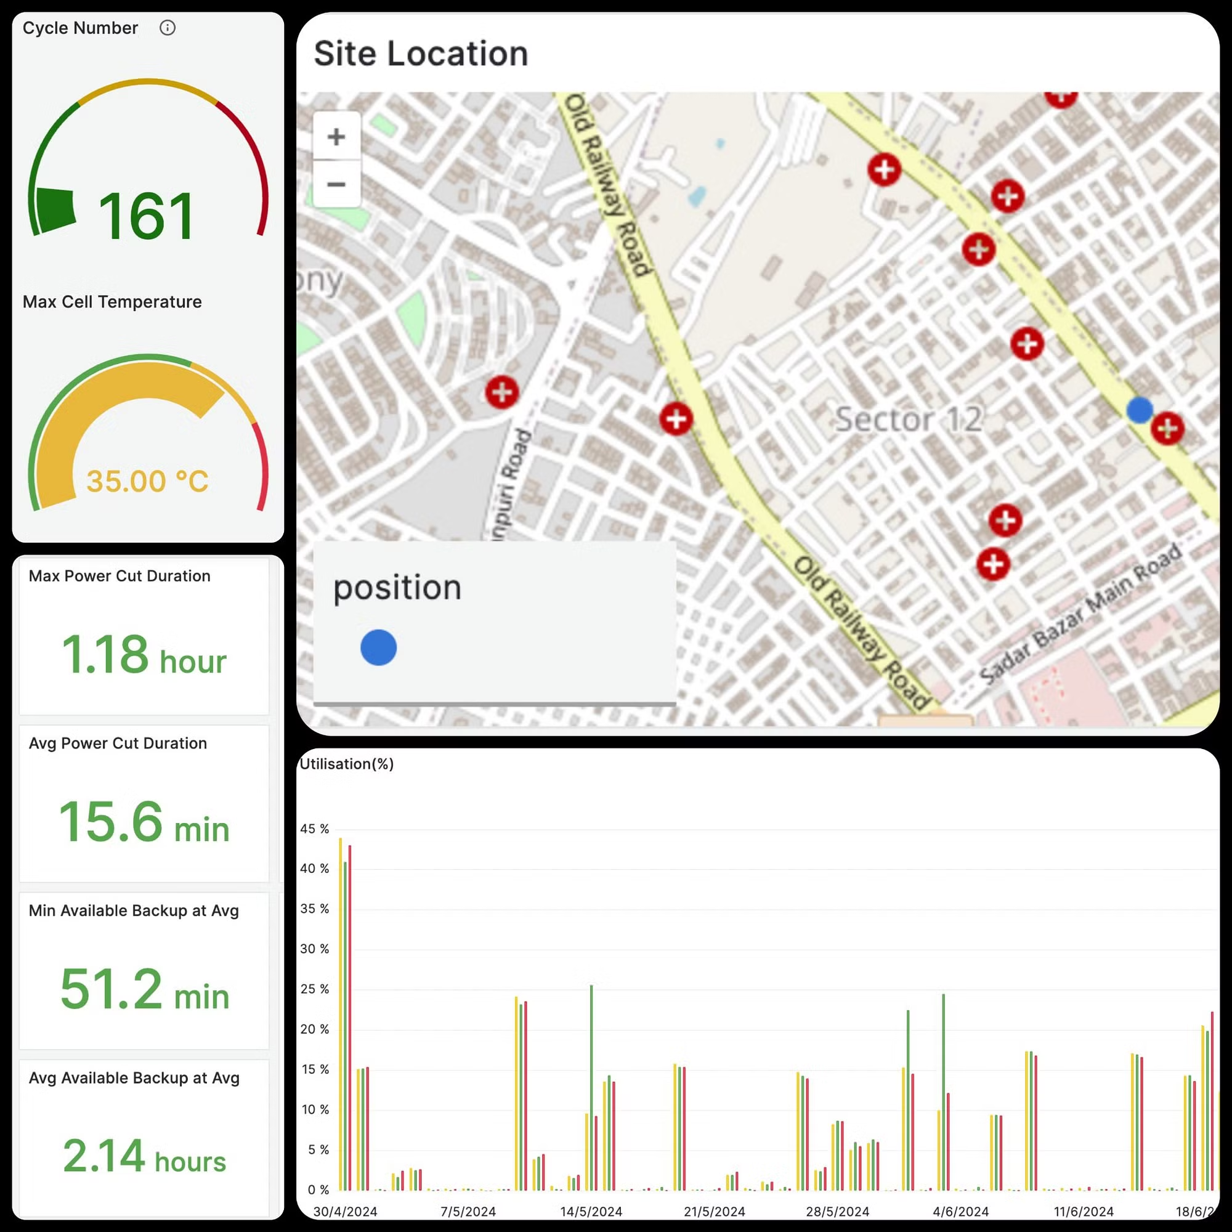
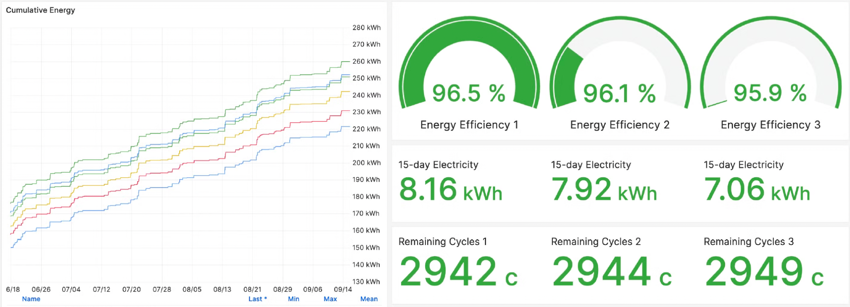
Introducing Preksha
Preksha is our SaaS offering that simplifies the process of working with batteries and their data.
Accessible via web and mobile, it allows you to be in control of your batteries, understand insights, and to use those insights to safely and optimally conduct your operations.

Slide 6
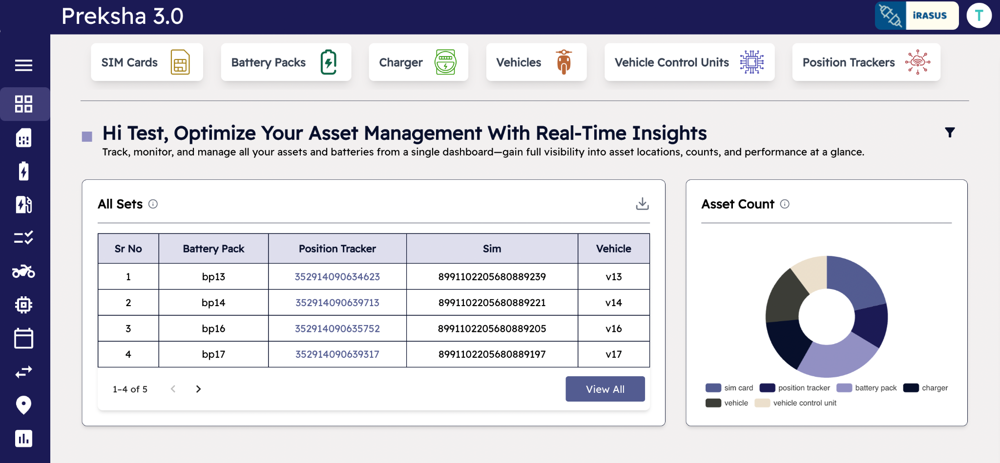
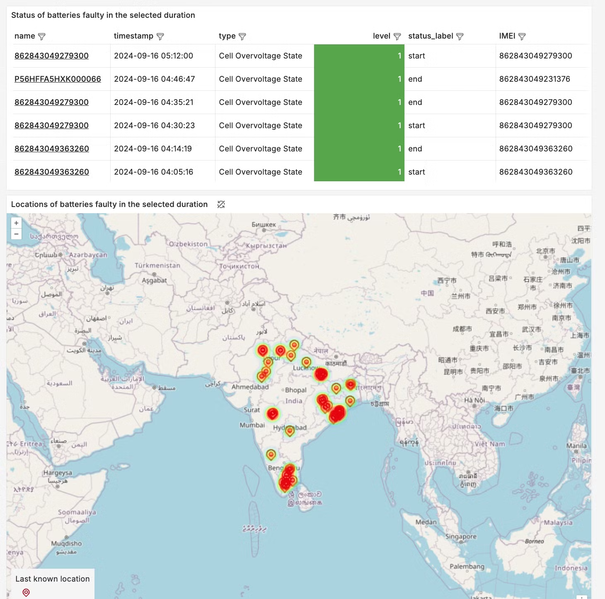
Simplifying battery and adjacency asset management and analytics
Monitor faults and conduct RCA

Slide 7
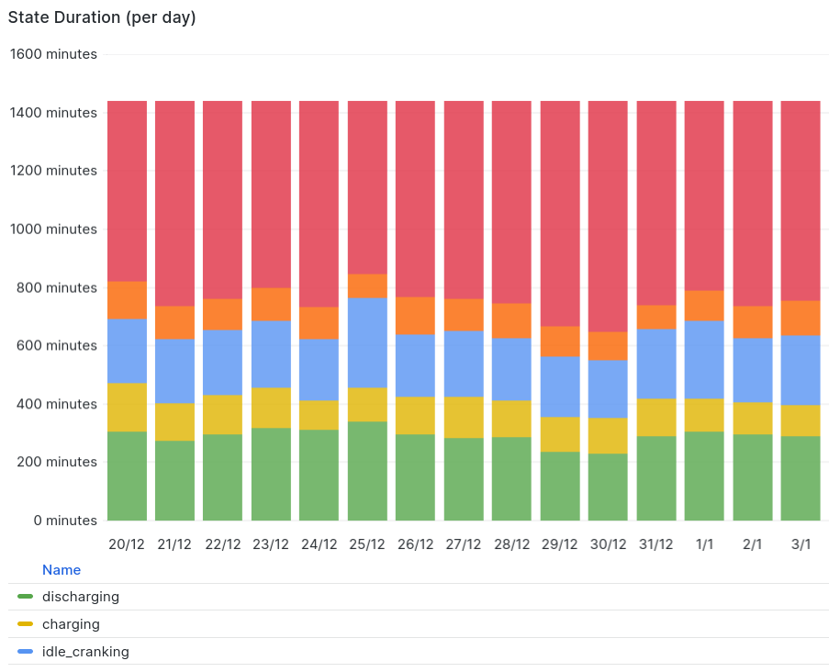
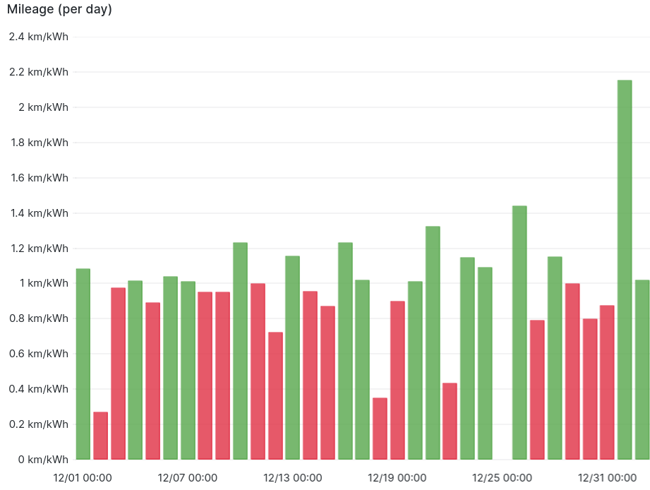
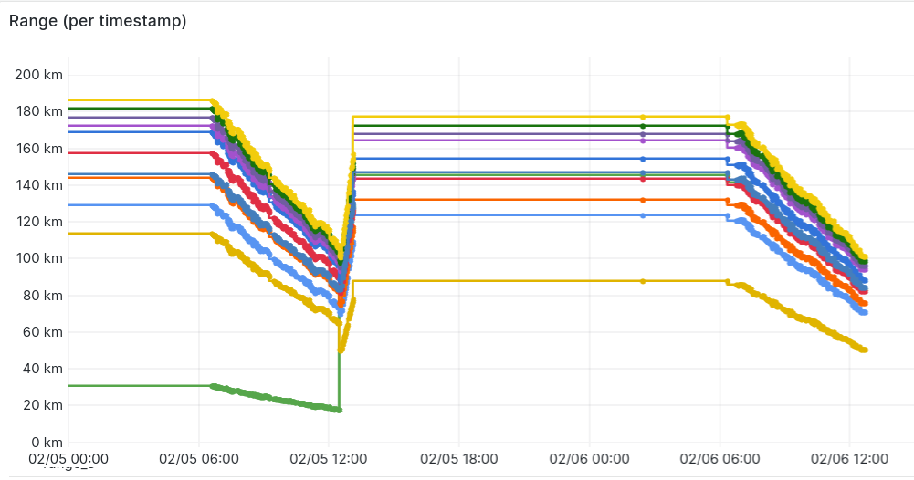
Real-Time insights into organisation-wide operations
1000+ indicators being monitored in real-time to generate your battery profile
On the go RCA-aided exploration designed by battery system experts

Slide 8
Key Features - I
Gain real-time insights into hundreds of battery metrics
Proactively identify potential issues to prevent battery health degradation
Battery Health Metrics
Set and get instant notifications of faults and anomalies
Prevent costly downtime and safety hazards
Remote Diagnostics & Alerts
Monitor battery in real-time and establish virtual geofencing
Ensure proper route planning and prevent unauthorized movement
Location and Geofencing

Slide 9
Key Features - II
Build on top of cleaned data via our machine learning stack
Predict remaining range, tag points of interests, estimate state of health and much more with our intelligent models
AI Models
Integrate with existing fleet management systems
Streamline workflows and facilitate data-driven decision-making
API Integration
Access insights into battery performance through real-time reports
Make informed decisions across your operations
Reporting & Analytics

Slide 10














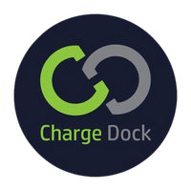

Clients and PoC’s
Key Partnerships

Slide 11
Get in Touch with us
arjun@irasus.com | +91 99207 19205
Desqworx, Club Patio, Block E, South City I, Gurugram, Haryana-122022

